Slide 1

Analysis of Bicycle Accident Patterns in Chicago
Kelsey Li

Slide 2
Motivation
Bicycle safety is an increasingly urgent issue in urban transportation planning, as cities encourage more residents to choose cycling for its health and environmental benefits. While many studies have examined overall crash rates, far fewer have compared how crash patterns differ between privately owned bicycles and shared‐bike systems, especially when accounting for rider demographics and time‐of‐day effects.

Slide 3
Project Purpose
Assess how bicycle crash patterns differ between owned and Divvy rental bikes
Investigate effects of rider age and time of day on crash severity
Notes:
“In this project, my goal is to compare bicycle crash patterns in Chicago between privately owned bikes and Divvy rental bikes. I will focus on how rider age and time of day influence crash severity. Ultimately, I aim to provide targeted recommendations for improving safety in urban bike infrastructure and for bike‑share operators.

Slide 4
Hypotheses
More and more accidents occur as time goes by
Younger riders have higher no-injury crash rates
Owned and rental bikes show different hourly crash peaks
Notes:
“I have three main hypotheses for now, and I will add more hypothesis for further work:
More and more accidents occur as time goes by
Younger riders have higher no-injury crash rates
Owned and rental bikes show different hourly crash peaks Next, I will test these hypotheses using our integrated datasets.”

Slide 5
Design & Methods
Data integration: Traffic Crashes – People & Divvy trip data
Feature extraction: AGE groups, TimePeriod, CrashType, VehicleType
Analyses: Descriptive stats, time-series plots, linear regression
Notes:
“To test these hypotheses, I first compare the divvy rental bike record, which have informations about the start and end time and start and end location. Then I want to find in which accident, the bike was rental. So I basically match the end time and location to the crashes dataset, if a crash happened within 5 minutes and 50 meters to the end of bike rental, I will say this is the crash that the involved bike is rental. After that I extracted features such as age groups, time periods, crash type (injury vs. no‑injury), and vehicle type. My analysis approach includes:
Descriptive statistics to compare total crashes and proportions;
Time‑series plotting by month and by hour;
Linear regression to examine the relationship between age and no‑injury rate.”

Slide 6
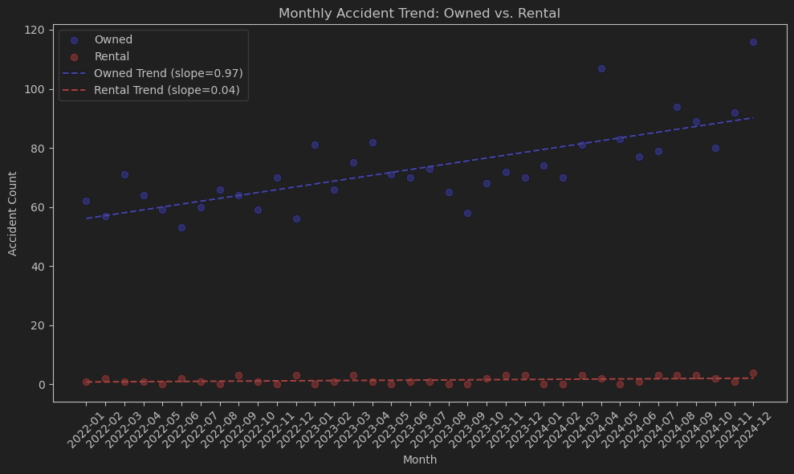
Results So Far
Hypothesis 1:
More and more accidents occur as time goes by
Month OwnedCount RentalCount
0 2022-01 62 1.0
1 2022-02 57 2.0
2 2022-03 71 1.0
3 2022-04 64 1.0
4 2022-05 59 0.0
5 2022-06 53 2.0
6 2022-07 60 1.0
7 2022-08 66 0.0
8 2022-09 64 3.0
9 2022-10 59 1.0
10 2022-11 70 0.0
11 2022-12 56 3.0
12 2023-01 81 0.0
13 2023-02 66 1.0
14 2023-03 75 3.0
15 2023-04 82 1.0
16 2023-05 71 0.0
17 2023-06 70 1.0
18 2023-07 73 1.0
19 2023-08 65 0.0
20 2023-09 58 0.0
21 2023-10 68 2.0
22 2023-11 72 3.0
23 2023-12 70 3.0
24 2024-01 74 0.0
25 2024-02 70 0.0
26 2024-03 81 3.0
27 2024-04 107 2.0
28 2024-05 83 0.0
29 2024-06 77 1.0
30 2024-07 79 3.0
31 2024-08 94 3.0
32 2024-09 89 3.0
33 2024-10 80 2.0
34 2024-11 92 1.0
35 2024-12 116 4.0
This hypothesis is partly correct with a 0.97 slope of Owned, a 0.04 subtle slope of Rental
Notes:
The main reason of this result is the limited scale of rental bike. The data are too scarce for regression.
coef_owned=np.polyfit(time_summary['MonthNum'],time_summary['OwnedCount'],1) trend_owned=np.poly1d(coef_owned)
Use numpy, polyfit

Slide 7
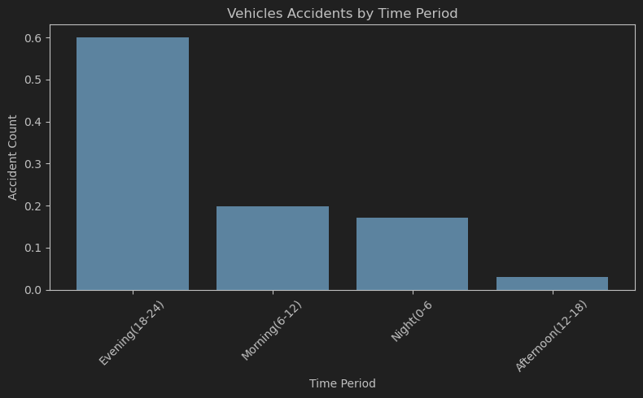
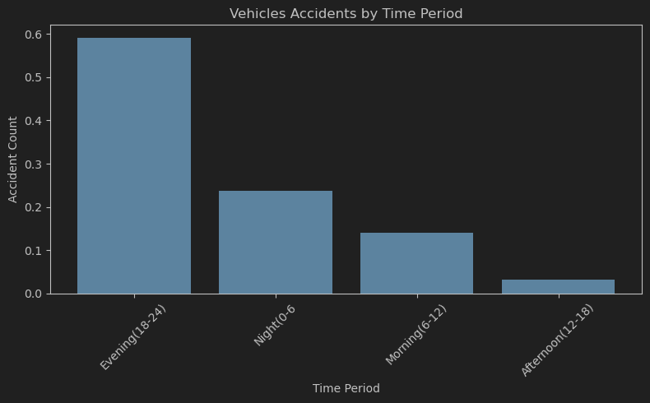
Results So Far
Hypothesis 2:
Private‐owned bikes and rental bikes show different peak crash times by hour.
This hypothesis is wrong
Owned bike and rental bike share the truth: most crashes happened in evening.
Owned Bike:
TimePeriod
Evening(18-24) 2652
Morning(6-12) 879
Night(0-6 754
Afternoon(12-18) 133
Rental Bike
TimePeriod
Evening(18-24) 55
Night(0-6 22
Morning(6-12) 13
Afternoon(12-18) 3
Notes:
As you can see from the graph, The hypothesis is wrong. Owned bike and rental bike share the truth: most happened in evening.
Actually it is kinda suprising for me because I proposed this hypothesis considering tourist could be the biggest customer for bike rental. So they should have different time using bikes, probabaly in afternoons.
The difference appears to the second highest crash time. For owned bike it is morning, for rental bike it is night. This part of result infact matches what I expected. For people have their own bike, they probably residents who have a job in this city. Accident may happened when they were on their way to office. For people who rent bikes, I assume they are tourists as I said, accident may happened when they were enjoying their night time at chicago,.

Slide 8
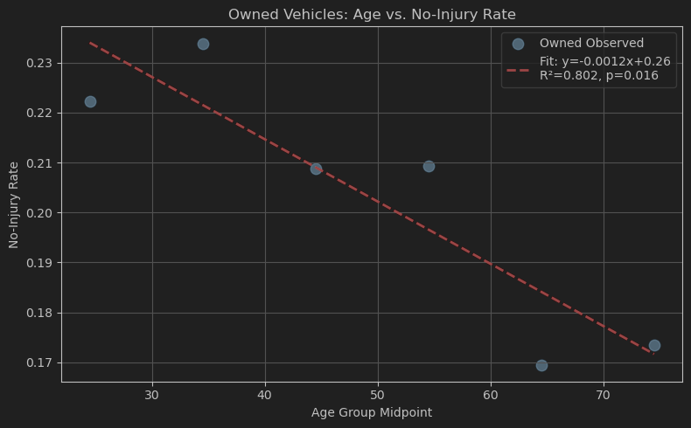
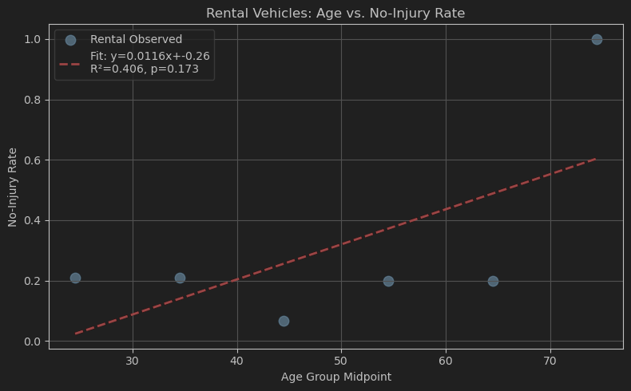
Results So Far
This hypothesis partly correct. No injury rate for owned bike goes down as age goes up.
Now clear result for rental bike.
Hypothesis 3:
Either they are riding rental or owned bikes, younger people (children excluded) are tended to have no injury when an accident happened.
Notes:
When tackling this section, I get rid of age group above 80 because the data could be very rare.
As you can see in the left graph, which shows the relationship between age and no injury rate for owned bikes, they have a linear relationship, No injury rate goes down as age goes up. The p value is less than 0.05.
Yet there is no clear result for rental part, the p value is more than 0.05, because of the lack of data.

Slide 9
Further work
limitation
Deeper analysis
Lack of enough data for rental part
Pull in weather data (temperature, precipitation, visibility) and lighting conditions to see how they modulate crash risk by bike type or age group.
map high‑crash “hot zones,” then compare where owned vs. rental crashes cluster.
Notes:
For now, Even if I match data between 2022-2024 these 2years, nearly millions of record, the biggest limitation is lack of enough data for rental part, and it is really hard for me to tackle. Looking ahead, I plan to deepen the analysis in two key ways. First, I will pull in environmental and road‑condition data—such as temperature, precipitation, visibility, and lighting—to see how weather and infrastructure influence crash risk by bike type or age group. Second, I will perform a spatial hotspot study, using kernel density mapping to identify high‑crash zones and compare where owned versus rental bikes cluster. These extensions should help move from high‑level summaries to more actionable insights for both city planners and bike‑share operators.

Slide 10
Thank you

